Slide 1
CONTENT
What is Network Interface card (NIC) ?
Components of NIC
Types of NIC
Advantages of NIC
Disadvantages of NIC

Slide 2
What is Network Interface card (NIC) ?
Network Interface Card (NIC) is a hardware component that is present on the computer. It is used to connect different networking devices such as computers and servers to share data over the connected network. It provides functionality such as support for I/O interrupt, Direct Memory Access (DMA) interfaces, partitioning, and data transmission.

Slide 3
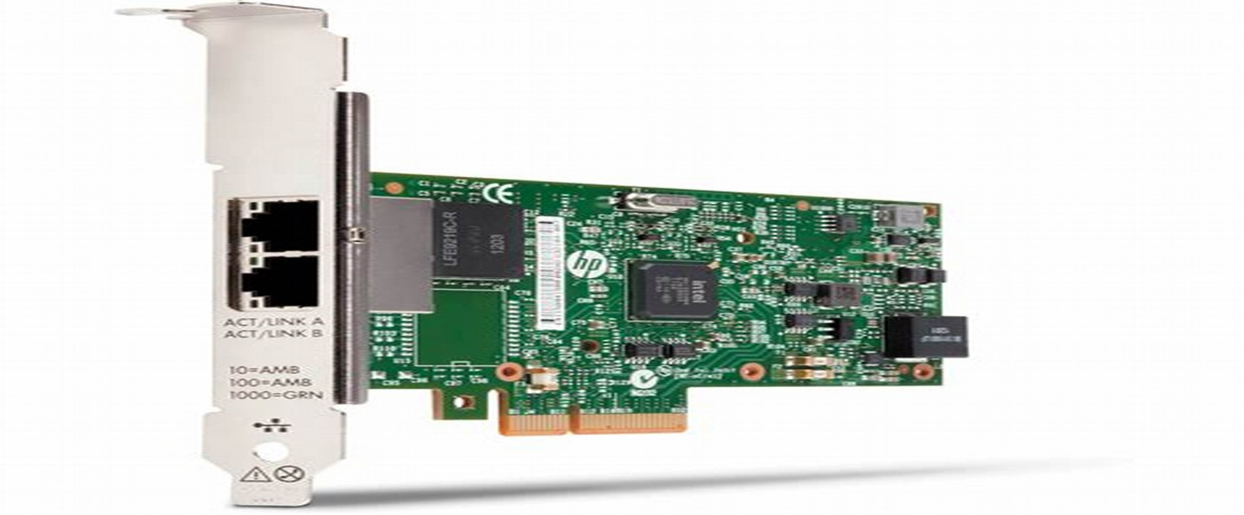
NIC is important for us to establish a wired or wireless connection over the network.
Network Interface Card is also known as Network Interface Controller, Network Adapter, Ethernet card, Connection card, and LAN (Local Area Network) Adapter.

Slide 4
Components of Network Interface Card
Network Interface Card contains the following essential components -
1. Memory:-
Memory is one of the most important components of the NIC. It is used to store the data during communication.
2. Connectors:-
connectors are used to connect the cables to the Ethernet port.

Slide 5
3. Processor
Processor is used for converting the data message into a suitable form Of communication.
4. Jumper
The jumper controls the communication operation.
5. MAC address
MAC address is also referred to as a physical network address.

Slide 6
Types of Network Interface Cards
Ethernet NIC
Ethernet NIC was developed by Robert Metcalf in 1980. It is made by ethernet cables. This type of NIC is most widely used in the LAN, MAN, and WAN networks.
2. Wireless Networks NIC
It is a wireless network that allows us to connect the devices without using the cables. These types of NICs are used to design a Wi-Fi connection.

Slide 7
Advantages of NIC
Communication speed is high.
Network Interface cards are not expensive.
NICs are easy to troubleshoot.

Slide 8
Disadvantages of NIC
Security is minimal low.
Information is unstable.
The design should be legitimate for better correspondence.

Slide 9
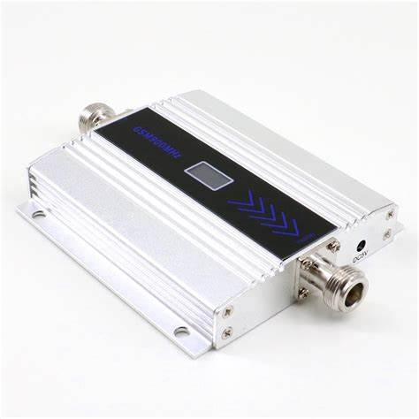
Repeater
What is Repeater?
A repeater is a dynamic network device used to reproduce the signals when they transmit over a greater distance so that the signal’s strength remains equal. It can be used to create an Ethernet network. A repeater that occurs as the first layer of the OSI layer is the physical layer.

Slide 10
Advantages of Repeater
They are cost effective.
They can connect signals using different types of cables.

Slide 11
Disadvantages of Repeater
They cannot reduce network traffic or congestion.
They cannot differentiate between actual signal and noise.
Repeaters cannot connect dissimilar networks.

Slide 12
Hub
What is Hub?
A hub is the most basic networking device that connects multiple computers or other network devices. Unlike a network switch or router, a network hub has no routing tables or intelligence on where to send information and broadcasts all network data across each connection.

Slide 13
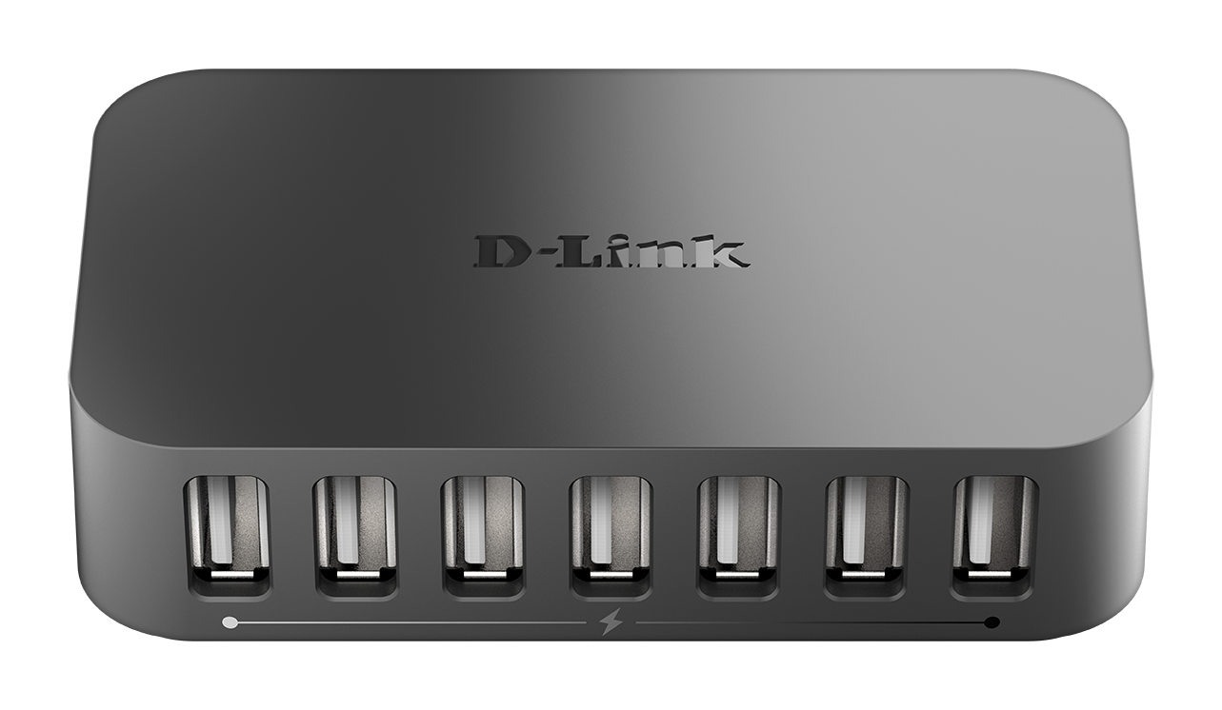
Most hubs can detect basic network errors, such as collisions, but having all information broadcast to multiple ports is a security risk and causes bottlenecks.

Slide 14
Types of hub
Active hub:-
Active hub is multi-point repeater with capability of regeneration of signals.
Passive hub:-
Passive hub is just a connector which connects wire coming from other devices.

Slide 15
Advantages of hub
It is cheaper in other devices.
Supports a lot of network media.
Distributes the performance of the network.

Slide 16
Disadvantages of hub
Do not filter the data.
The network does not reduce traffic.
Do not reproduce the data.

Slide 17
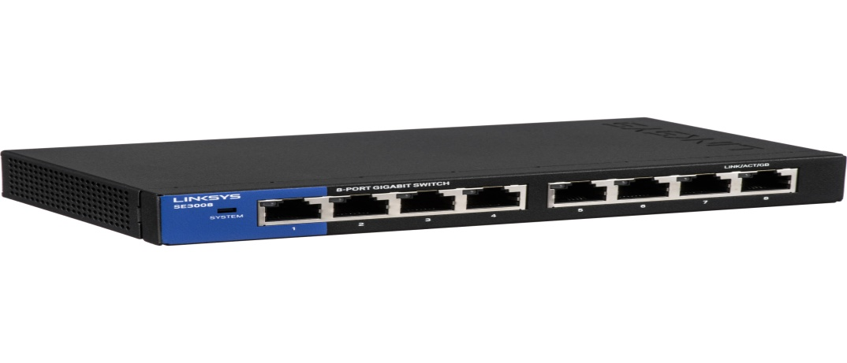
Switch
What is Switch?
On a network, a switch is a hardware device that filters and forwards network packets, but is often not capable of more. A network switch is more advanced than a hub, but not as advanced as a router. The picture shows an example of a NETGEAR 5 port switch.

Slide 18
Types of Switches
Basically, Switches can be of two types. They are:
Mechanical
Mechanical Switches are physical switches, which must be activated physically, by moving, pressing, releasing, or touching its contacts.
Electronic
Electronic Switches, on the other hand, do not require any physical contact in order to control a circuit. These are activated by semiconductor action.

Slide 19
Advantages of switch
They increase the available bandwidth of the network.
They increase the performance of the network.

Slide 20
Disadvantage of switch
They are more expensive compare to network bridges.
Broadcast traffic may be troublesome.

Slide 21


